Slide 1
SPARK CORE
SPARK CORE. PART 1

Slide 2
Current module objectives
WHAT YOU’LL LEARN
What is Spark
Spark Architecture and Components
Spark Installation
RDD and its operations

Slide 3
Introduction

Slide 4

What is Spark?
Spark is a fast growing and general engine for large-scale data processing
Up to 100x faster than MapReduce
Runs on Hadoop, Mesos, standalone, or in the cloud
Support for many programming languages
SQL, streaming, and complex analytics
Multiple options and libraries
Notes:
Apache Spark is an open-source cluster-computing framework designed for speed and ease of use. Spark is well-known for its in-memory performance, but that has also given rise to misconceptions about its on-disk abilities. Spark is in fact a general execution engine – which has a greatly improved performance both in-memory as well as on-disk, when compared with older frameworks like MapReduce.
Apache Spark has created a lot of buzz recently. In fact, beyond the buzz, Apache Spark has seen phenomenal adoption and has been marked out as the successor to Hadoop MapReduce.
Spark is highly accessible, offering few API for Scala, Java, Python, R, and SQL. Another important things, which makes Spark an interesting option is the amount of integrated libraries (machine learning, sql, streaming). We will take a look at it later on.

Slide 5
Spark History
Notes:
Spark was initially started at University of California, Berkeley AMPLab in 2009, and open sourced in 2010 under a BSD license. In 2013, the project was donated to the Apache Software foundation and switched its license to Apache 2.0. In February 2014, Spark became a Top level Apache Project.
In 2016 Apache Spark 2.0 has been released with updated SQL support, structured streaming and better performance. The most recent version at the moment is 2.3, which will be covered in this course.
(please note, we use v.2.2.1 because at the moment of the course writing that was last available version)

Slide 6
Spark vs Hadoop
Notes:
Spark is a cluster-computing framework, which means that it competes more with MapReduce than with the entire Hadoop ecosystem. For example, Spark doesn’t have its own distributed filesystem, but can use HDFS.
There’s no lack of information on the Internet about how fast Spark is compared to MapReduce. The thing about comparing these two is that they perform processing differently. MapReduce is a batch-processing engine. MapReduce operates in sequential steps by reading data from the cluster, performing its operation on the data, writing the results back to the cluster, reading updated data from the cluster, performing the next data operation, writing those results back to the cluster and so on. Spark performs similar operations, but it does so in a single step and in memory. It reads data from the cluster, performs its operation on the data, and then writes it back to the cluster. The reason that Spark is so fast is that it processes everything in memory. Yes, it can also use disk for data that doesn’t all fit into memory.

Slide 7
Spark vs Hadoop MapReduce…
 | Hadoop MapReduce | Apache Spark
Coding | complex, lengthy | compact
Coding complexity | difficult | easy
Interactive mode | no | yes
Developed in | Java | Scala
Language support | Java, C/C++, Ruby, Python, … | Scala, Java, Python, R, SQL
OS support | Linux, Windows, Max OS | Linux, Windows, Mac OS
Latency | disk oriented | memory oriented
Performance | lower | faster
Hardware | commodity | mid to high-level
Notes:
From coding perspective:
MapReduce requires more lines of the code comparing to Spark, where the same task will take less space
MapReduce is a bit complex comparing to Spark. MapReduce is difficult to write and debug, unlike Spark
Spark has an interactive mode
MapReduce has been developed in Java, while Spark in Scala
Primary language for MapReduce is Java, although languages like C, C++, Ruby, Python, Perl, Groovy has also supported; Apache Sparks supports Scala, Java, Python, R, and SQL
Both can be installed and used on different platforms
MapReduce is strictly disk-based while Apache Spark uses memory and can use a disk for processing
MapReduce is slower than Apache Spark, because of I/O disk latency; Apache Spark reports to be 100x faster in memory and 10x faster while running on disk
MapReduce can be an economical option because of Hadoop as a Service, and Spark is more cost effective because of high availability memory; i.e. MapReduce can work with commodity hardware, when Spark better works on mid- to high-level hardware
SOURCES:
- https://www.educba.com/mapreduce-vs-apache-spark/

Slide 8
…Spark vs Hadoop MapReduce
 | Hadoop MapReduce | Apache Spark
Category | data processing engine | data analytics engine
Data processing | Batch | batch, streaming
Flow scheduler | 3rd party (e.g. Oozie) | built-in
Fault tolerance | replication | RDD
Recovery | resilient | DAG / checkpoints
Security | Kerberos / ACLs | Shared secret password auth
Scalability | high | high
Machine learning | 3rd party (e.g. Apache Mahout) | Spark ML, MLlib
Notes:
Comparing features:
MapReduce is a Data Processing Engine, i.e. ….; Spark is a Data Analytics Engine, i.e. ….
MapReduce is meant for batch processing only, when Spark is for Batch Processing as well as for Real Time Data Processing (streaming)
MapReduce has no built-in flow scheduler, but there are 3rd party projects to be used for that (i.e. Oozie)
MapReduce uses replication for fault tolerance; Apache Spark uses RDD and other data storage models for fault tolerance
RECOVERY
MapReduce is more secured comparing to Apache Spark, but security features in Apache Spark is more evolving and getting matured
Both are scalable, but limited to 1000 nodes in a single cluster
MapReduce is more compatible with apache Mahout while integrating with Machine Learning, Apache Spark has built-in API for Machine Learning (SparkML, Mllib)
SOURCES:
- https://www.educba.com/mapreduce-vs-apache-spark/

Slide 9
Code compare
Hadoop MapReduce
Apache Spark
package com.epam.sample.mapreduce import … object WordCount { class Map extends Mapper[Object, Text, Text, IntWritable] { val one = new IntWritable(1) val word = new Text() override def map(key: Object, value: Text, context: Mapper[Object, Text, Text, IntWritable]#Context): Unit = { val tokenizer = new StringTokenizer(value.toString) while (tokenizer.hasMoreTokens) { word.set(tokenizer.nextToken()) context.write(word, one) } } } class Reduce extends Reducer[Text, IntWritable, Text, IntWritable] { override def reduce(key: Text, values: Iterable[IntWritable], context: Reducer[Text, IntWritable, Text, IntWritable]#Context): Unit = { var sum = values.asScala.foldLeft(0)(_ + _.get) context.write(key, new IntWritable(sum)) } } def main(args: Array[String]): Unit = { val conf = new Configuration val job = Job.getInstance(conf, "word count") job.setJarByClass(this.getClass) job.setMapperClass(classOf[Map]) job.setCombinerClass(classOf[Reduce]) job.setReducerClass(classOf[Reduce]) job.setOutputKeyClass(classOf[Text]) job.setOutputKeyClass(classOf[Text]) job.setOutputValueClass(classOf[IntWritable]) FileInputFormat.addInputPath(job, new Path(args(0))) FileOutputFormat.setOutputPath(job, new Path(args(1))) System.exit(if (job.waitForCompletion(true)) 0 else 1) } }
package com.epam.sample.spark import org.apache.spark.{SparkConf, SparkContext} object WordCount { def main(args: Array[String]): Unit = { val conf = new SparkConf() .setAppName(“Word Count") .setMaster("local[*]") val sc = new SparkContext(conf) val textFile = sc.textFile(args(0)) val counts = textFile.flatMap(line => line.split(" ")) .map(word => (word, 1)) .reduceByKey(_ + _) counts.saveAsTextFile(args(1))
sc.stop() } }
Notes:
Let’s compare simple Word Count examples which are implemented by using both MapReduce and Spark. To make it fair enough, both are written in Scala.
If you notice, it took more than twice less to implement WordCount program using Spark. So Spark is a really powerful data processing tool both from a latency and readability point of view.

Slide 10
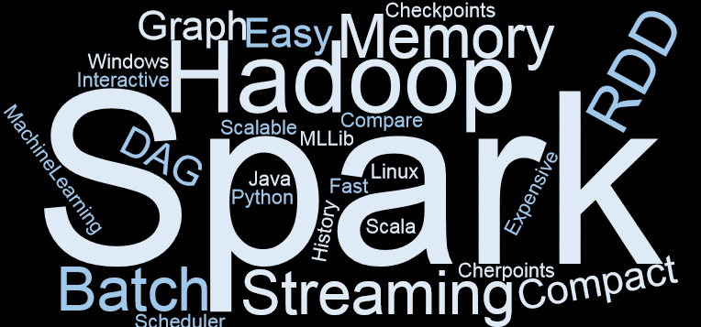
Summary
Notes:
In this section we introduced and briefly touched Spark, comparing it to Hadoop MapReduce

Slide 11
SPARK ARCHITECTURE AND COMPONENTS

Slide 12
Spark components
Spark SQL
Structured Data
Spark Streaming
Real-time
Mllib &Spark ML
Machine Learning
GraphFrames
Graph Processing
Spark Core
Core abstraction and processing engine
Scala
Java
Python
SQL
R
Local Scheduler
Standalone Scheduler
YARN
Hadoop Cluster Manager
Mesos
Kubernetes (experimental)
Notes:
Spark Core – provides basic functionality of Apache Spark, including RDDs and APIs to manipulate them.

Slide 13
Spark components
Spark SQL
Structured Data
Spark Streaming
Real-time
Mllib &Spark ML
Machine Learning
GraphFrames
Graph Processing
Spark Core
Core abstraction and processing engine
Scala
Java
Python
SQL
R
Local Scheduler
Scandal one Scheduler
YARN
Hadoop Cluster Manager
Mesos
Kubernetes (experimental)
Notes:
The heart of Apache Spark is the Spark Core. It provides the distributed task dispatching, scheduling, basic input and output operations, and the RDD abstraction and APIs to manipulate it. It interacts with its scheduler to schedule tasks and it interacts with a cluster manager to send tasks to machines to be executed. The few cluster managers (Apache Mesos, Hadoop YARN, and recently Kubernetes), manage the underlying data that we want to analyze.
Spark SQL – A new component which replaces the older Shark (SQL on Spark) project, this package provides better integration with Spark Core, it allows querying data through SQL and HiveQL and supports many data sources from Hive tables, Parquet and JSON. Spark SQL also allows developers to intermix SQL queries with the code for data manipulations with RDDs in Python, Java, and Scala. It also provides fast SQL connectivity to BI tools like Tableau or QlikView.
Spark Streaming – based on micro-batching, this component enables processing of real-time streaming data. It uses DStreams, which are series of RDDs, to process real-time data. The Spark Streaming API is very similar to the Spark Core RDD APIs, making it easy for developers to reuse and adapt code for batch to interactive or real-time applications.
MLlib – provides a library of machine learning algorithms including classification, regression, clustering, and collaborative filtering, as well as model evaluation and data import.
GraphFrames – which provides dataframe-based graphs. It aims to provide both the functionality of GraphX (which is now deprecated) and extended functionality taking advantage of spark data frames. This extended functionality includes motif finding, dataframe-based serialization and highly expressive graph queries.

Slide 14
Spark applications
Driver Program
Spark context
Executor
User code
Cluster manager
Notes:
Spark Applications consist of a driver process and a set of executor processes.
The driver process sits on the driver node and is responsible for three things:
maintaining information about the Spark application;
responding to a user’s program;
analyzing, distributing, and scheduling work across the executors
An executor is responsible for two things: executing code assigned to it by the driver and reporting the state of the computation back to the driver node.
The last piece for us is the cluster manager. It controls physical machines and allocates resources to Spark applications. As said before, it can be Standalone Cluster Manager, YARN, Mesos, Kubernetes. We can have multiple Spark applications running on a cluster at the same time
SOURCES:
Spark. The Definitive Guide

Slide 15
Spark applications
Driver Program
Spark context
Executor
User code
Cluster manager
Notes:
Spark Applications consist of a driver process and a set of executor processes.
The driver process sits on the driver node and is responsible for three things:
maintaining information about the Spark application;
responding to a user’s program;
analyzing, distributing, and scheduling work across the executors
An executor is responsible for two things: executing code assigned to it by the driver and reporting the state of the computation back to the driver node.
The last piece for us is the cluster manager. It controls physical machines and allocates resources to Spark applications. As said before, it can be Standalone Cluster Manager, YARN, Mesos, Kubernetes. We can have multiple Spark applications running on a cluster at the same time
SOURCES:
Spark. The Definitive Guide

Slide 16
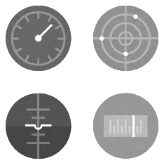
Spark Driver
Notes:
A Spark driver (aka an application’s driver process) is a JVM process that hosts SparkContext for a Spark application. It is the master node in a Spark application.
It is the cockpit of jobs and tasks execution (using DAGScheduler and Task Scheduler). It hosts Web UI for the environment.
As already said, driver has many responsibilities
splits application into tasks and schedules them to run on executors
spawns tasks across workers (using task scheduler)
coordinates workers and overall execution of tasks
It also requires many additional services, like:
ShuffleManager to track shuffle dependencies
MemoryManager to manage shared memory for execution and storage (execution memory is used for computation in shuffles, joins, sorts and aggregations; shared memory is used for caching and propagating internal data across the nodes in cluster)
BroadcastManager to manage broadcast variables (we will talk on them later)
Etc. etc.
SOURCES:
- https://jaceklaskowski.gitbooks.io/mastering-apache-spark/content/spark-driver.html

Slide 17

Spark context
val sc = new SparkContext(master=("local[*]"),
appName="SparkContext Sample",
new SparkConf)
val fileName = "people.csv"
val lines = sc.textFile(filename)
val count = lines.count()
println(count)
sc.stop()
Notes:
Spark Context is the heart of a Spark application.
Spark context sets up internal services and establishes a connection to a Spark execution environment.
Once a SparkContext is created you can use it to create RDDs, accumulators and broadcast variables, access Spark services and run jobs (until SparkContext is stopped).
A Spark context is essentially a client of Spark’s execution environment and acts as the master of your Spark application (don’t get confused with the other meaning of Master in Spark, though).
There is only one SparkContext per JVM. Although you may see spark.driver.allowMultipleContexts option, it is misleading as this one is used for internal Spark tests…
SOURCES:
- https://jaceklaskowski.gitbooks.io/mastering-apache-spark/content/spark-SparkContext.html#creating-instance

Slide 18
Spark session
val conf = new SparkConf().setMaster(master).setAppName(appName)
val sc = new SparkContext(conf)
val streamingContext = new StreamingContext(sc, Seconds(10))
val sqlContext = new SQLContext(sc)
val hiveContext = new HiveContext(sc)
val ss = SparkSession.builder.master(master).appName(appName)
.enableHiveSupport()
.getOrCreate()
Notes:
As we talk about Spark Context, there is another thing which comes along – a Spark Session. Prior to Spark 2.0.0, the three main connection objects were SparkContext, SqlContext, and HiveContext. The SparkContext object was the connection to a Spark execution environment and created RDDs and others, SQLContext worked with SparkSQL in the background of SparkContext, and HiveContext interacted with the Hive stores.
Spark 2.0.0 introduced Datasets/DataFrames as the main distributed data abstraction interface and the SparkSession object as the entry point to a Spark execution environment. I.e. SparkSession has merged SparkContext, StreamingContext, SQLContext and HiveContext in one object.
As we will see later, the SparkSession object unifies more than the context; it also unifies the process of reading data in different formats.
SOURCES:
Fast Data Processing with Spark 2
https://jaceklaskowski.gitbooks.io/mastering-spark-sql/spark-sql-SparkSession.html

Slide 19

Spark executor
Notes:
Executor is responsible for two things:
executing code assigned to it by the driver;
reporting the state of the computation back to the driver node;
Executors are managed exclusively by executor backends (part of Cluster Managers). They are identified by id and host on which they run.
Executors provide in-memory storage for RDDs that are cached in Spark applications and report heartbeat and partial metrics for active tasks to Driver node. It is recommended to have as many executors as data nodes and as many cores as you can get from the cluster.
SOURCES:
Spark. The Definitive Guide
https://jaceklaskowski.gitbooks.io/mastering-apache-spark/content/spark-Executor.html

Slide 20
Spark architecture
Notes:
Spark uses a master/worker architecture. There is a driver that talks to a single coordinator called master that manages workers in which executors run.
The driver and the executors run in their own Java processes. You can run them all on the same (horizontal cluster) or separate machines (vertical cluster) or in a mixed machine configuration.
SOURCES:
https://jaceklaskowski.gitbooks.io/mastering-apache-spark/content/spark-architecture.html

Slide 21
Job terms
Notes:
So far we talked about Spark Components, but nothing about data or transformation.
Spark operates on RDDs - Resilient Distributed Dataset. We will have a deep dive into RDDs later on, for now we just need to know that this is a fundamental data abstraction in Spark. Essentially it is Spark representation of a set of data, spread across multiple machines, with APIs to let you act on it. Formally, an RDD is a read-only, partitioned collection of records.
The Job is top level execution for any Spark application; which corresponds to an action. This action is called by driver program. Job is composed by a set of tasks arranged in stages. Computing a job is equivalent to computing the partitions of the RDD the action has been executed upon. Job submission happens right after the call an action.
A stage is a physical unit of execution. It is a step in a physical execution plan. A stage is a set of parallel tasks — one task per partition. In other words, a Spark job is a computation with that computation sliced into stages.
Task (aka command) is the smallest individual unit of execution that is launched to compute a RDD partition.
SOURCES:
http://dataottam.com/2017/12/09/the-4-key-concepts-in-the-anatomy-of-an-apache-spark-job/
https://jaceklaskowski.gitbooks.io/mastering-apache-spark/spark-dagscheduler-jobs.html
https://jaceklaskowski.gitbooks.io/mastering-apache-spark/spark-DAGScheduler-Stage.html
https://jaceklaskowski.gitbooks.io/mastering-apache-spark/spark-taskscheduler-tasks.html

Slide 22
Directed Acyclic Graph
Notes:
Another important notion in Spark is DAG.
Wikipedia: In mathematics and computer science, a directed acyclic graph (DAG /ˈdæɡ/), is a finite directed graph with no directed cycles. That is, it consists of finitely many vertices and edges, with each edge directed from one vertex to another, such that there is no way to start at any vertex v and follow a consistently-directed sequence of edges that eventually loops back to v again. Equivalently, a DAG is a directed graph that has a topological ordering, a sequence of the vertices such that every edge is directed from earlier to later in the sequence.
Adding the red edges to the blue directed acyclic graph produces another DAG, the transitive closure of the blue graph (transitive closure is the graph with the most edges that represents the same reachability relation).
So DAG contains a sequence of vertices such that every edge is directed from earlier to later in the sequence. It is a strict generalization of MapReduce model. The limitations of Hadoop MapReduce became a key point to introduce DAG in Spark. The computation through MapReduce is carried in three steps:
The data is read from HDFS.
Map and Reduce operations are applied.
The computed result is written back to HDFS.
Each MapReduce operation is independent of each other and Hadoop has no idea of which Map reduce would come next. Sometimes for some iteration, it is irrelevant to read and write back the immediate result between two map-reduce jobs. In multiple-step, till the completion of the previous job all the jobs are blocked from the beginning. As a result, complex computation can require a long time with small data volume.
While in Spark, a DAG (Directed Acyclic Graph) of consecutive computation stages is formed. In this way, the execution plan is optimized, e.g. to minimize shuffling data around. In contrast, it is done manually in MapReduce by tuning each MapReduce step.
SOURCES:
https://en.wikipedia.org/wiki/Directed_acyclic_graph
https://data-flair.training/blogs/dag-in-apache-spark/

Slide 23
Job Scheduling Process
val sc = new SparkContext(...)
val rdd1 = “employees.csv“
val rdd2 = “ projects.csv “
val result = rdd1.join(rdd2)
.groupBy(...)
.collect
Notes:
Let’s try making sense of all said before using a simple Spark code and see what’s happening when we run it.
First we create a Spark Context. Then we create an RDD there and after a list of transformation, we get a DAG.
Now, when an action is called, DAGScheduler will do its job: it splits graph into stages of tasks and submits each stage as ready.
Ok, DAGScheduler’s just submitted the taskSet to the TaskScheduler. Now, TaskScheduler does it job:
Launch tasks via cluster manager
Retry failed or straggling tasks
The backend will receive the worker list from the Cluster Manager, then it will launch Task at the Executor.. A BlockManager at each Executor will help it to deal with shuffle data and cached RDDs. New TaskRunner is created at the Executor and it starts the threadpool to process taskset.
SOURCES:
https://hxquangnhat.com/2015/04/03/arch-spark-job-submission-breakdown/

Slide 24
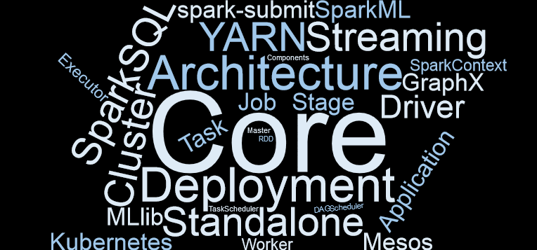
Summary

Slide 25
Spark Installation

Slide 26
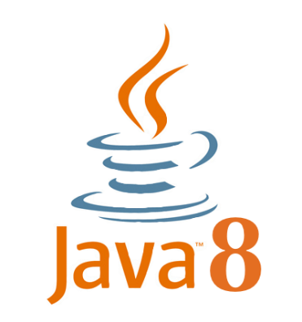
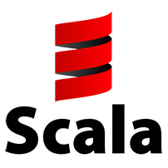



Prerequisites
JDK v1.8.0_b161
Scala 2.11
Community Edition v2017.3
Spark 2.2.1
Winutils for hadoop 2.7.1
Notes:
For this course we use Scala as a programming language for all our samples. Scala is a JVM based language, so we need a JDK to be installed.
Although Spark 2.3 is publicly available now, we used Spark 2.2.1 at the point of writing this course, so all the samples were tested there. Most probably there is no issue with using Spark 2.3 as well. For local executions Hadoop is not required, but if you are willing to run in cluster mode, Hadoop Yarn is nice to have.
Apache Spark is a cross-platform solution, but Linux is the best fit for development. Considering many of us use Windows as a host OS, we decided to build this course around Windows as well, and you may use Winutils to run it all. If Linux is an OS of your choice, Winutils is not required, just install Hadoop (or use a ready-to-use virtual machine distribution).
Technology set in this course does not depend on IDE, feel free to use the one you prefer. We will show how to configure Intellij IDE to develop and run Spark code samples there.
SOURCE:
https://medium.com/@GalarnykMichael/install-spark-on-windows-pyspark-4498a5d8d66c

Slide 27
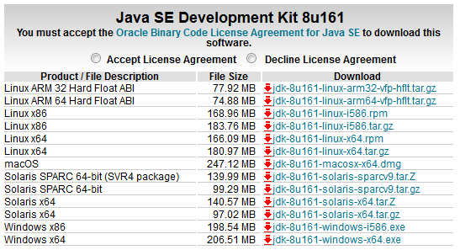
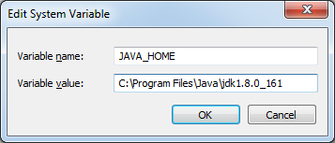
JDK
Notes:
Our first step is to install Java 8. Although Java 9 is available, its support by Hadoop is still in development.
Once JDK is downloaded and installed, please set up an environment variable called JAVA_HOME and point it to the JDK installation directory

Slide 28
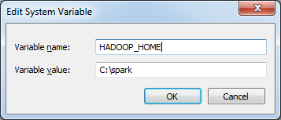
Winutils
Download WinUtils: https://github.com/steveloughran/winutils/blob/master/hadoop-2.7.1/bin/winutils.exe?raw=true
Create a directory C:\spark\bin and copy file downloaded there
Create a new Environment variable named HADOOP_HOME and point it to C:\spark
Notes:
Download binaries from Winutils repository. You should select the version of Hadoop the Spark distribution was compiled with, e.g. we use Hadoop-2.7.1 for Spark 2.
Save winutils.exe binary to a directory of your choice (c:\spark\bin in our case), and set an environment variable HADOOP_HOME to reflect that directory without bin

Slide 29
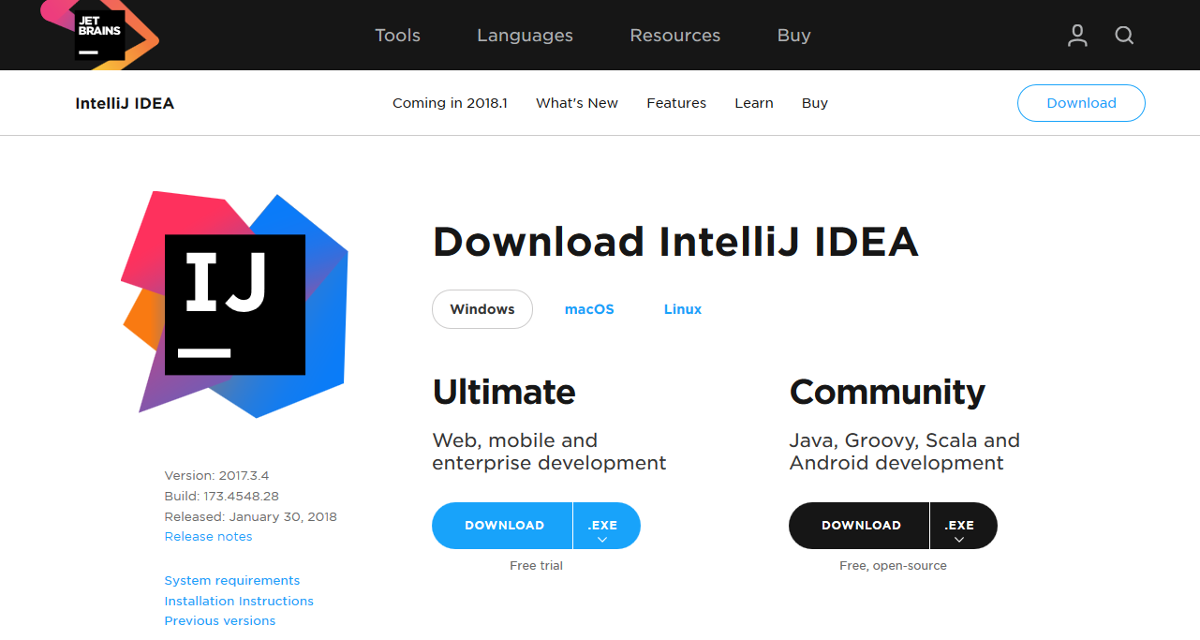
IDE
Intellij IDEA download page: https://www.jetbrains.com/idea/download
Notes:
Download binaries from Winutils repository. You should select the version of Hadoop the Spark distribution was compiled with, e.g. we use Hadoop-2.7.1 for Spark 2.
Save winutils.exe binary to a directory of your choice (c:\spark\bin in our case), and set an environment variable HADOOP_HOME to reflect that directory without bin

Slide 30
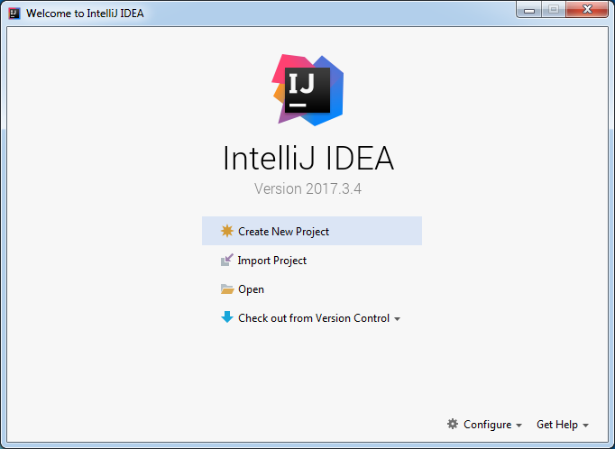
IDE Configuration
Start Intellij IDEA
Skip all configurations at startup and don’t install anything, until you get to the ‘create new project’ screen:
Notes:
Let’s configure the IDEA now. Please run it, you can skip all the configuration questions at the very beginning, until you see “create new project screen”.

Slide 31
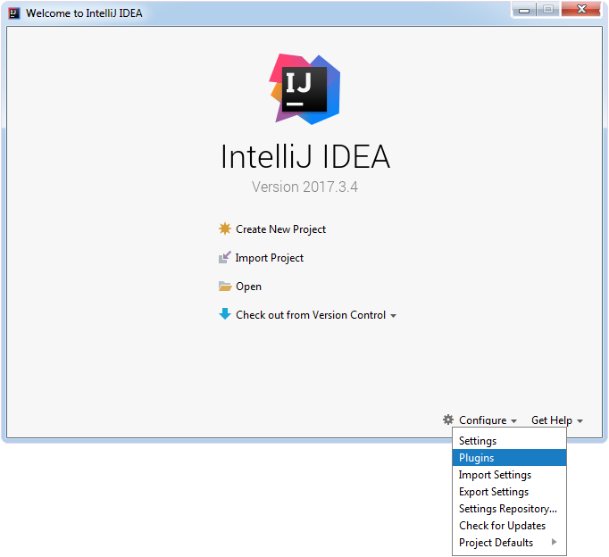
Installing IDE plugins
1
2
Notes:
Let’s configure the IDEA now. Please run it, you can skip all the configuration questions at the very beginning, until you see “create new project screen”.

Slide 32
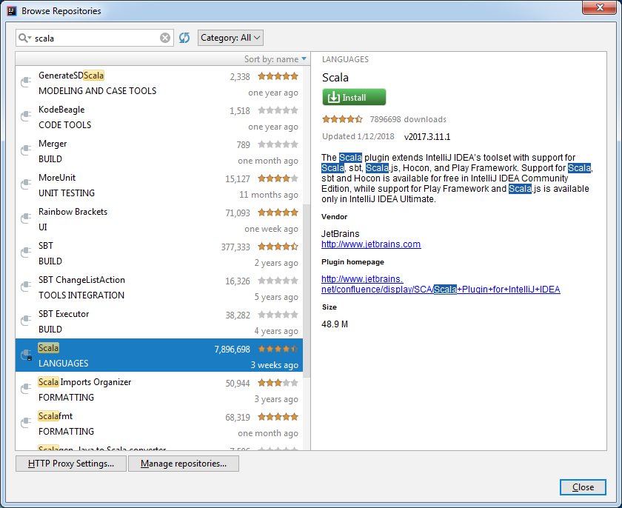
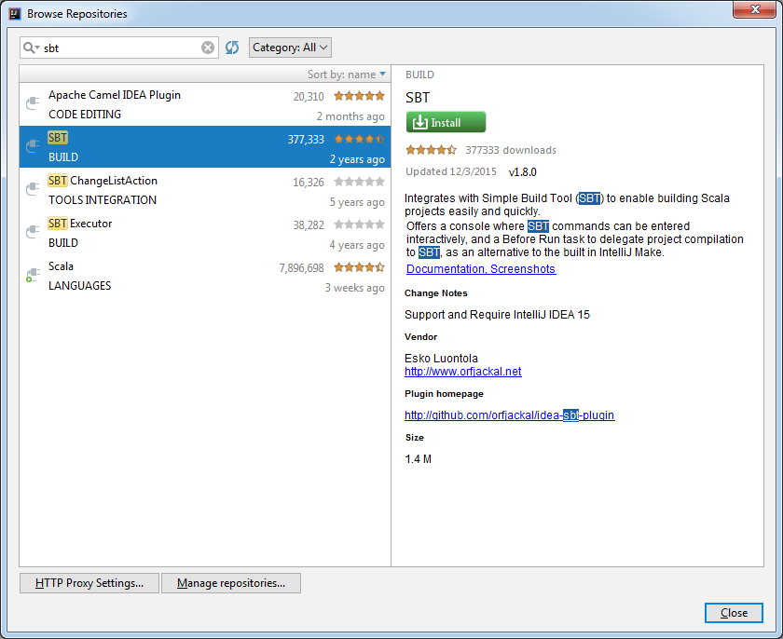
Scala & SBT plugins
1
4
3
6
5
2
Notes:
A window with Plugin Repository Browser will be opened, type in “scala” in search input at the top left, then scroll down a bit in search results and when you find “Scala” there, press “Install” button.
When done, we may need one more plugin to be installed – SBT. SBT stands for Simple Build Tool, and is an open-source build tool for Scala and Java projects, similar to Java’s Gradle. Same steps: first type in SBT into the search input, find it in search results and click “Install” button.

Slide 33
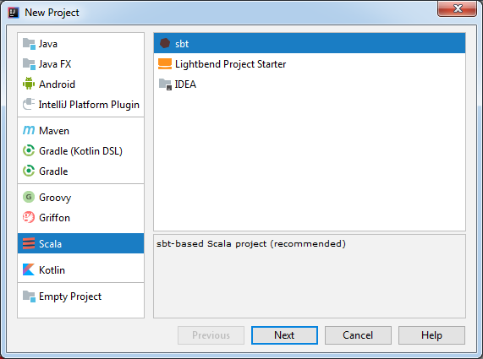
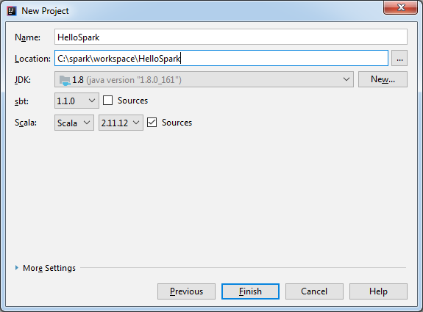
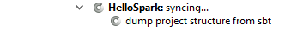
Create new project
2
4
5
1
3
6
7
Notes:
Now we are back to project creation. Please select Scala (so it is going to be a Scala project), then select SBT (so it is going to be an SBT-built project) and press Next.
Then you will be prompt to enter project Name and select its location. Please note what Scala version is chosen and change to Scala 2.11.x if another is used. And press Finish. You will see that project structure is getting created.

Slide 34
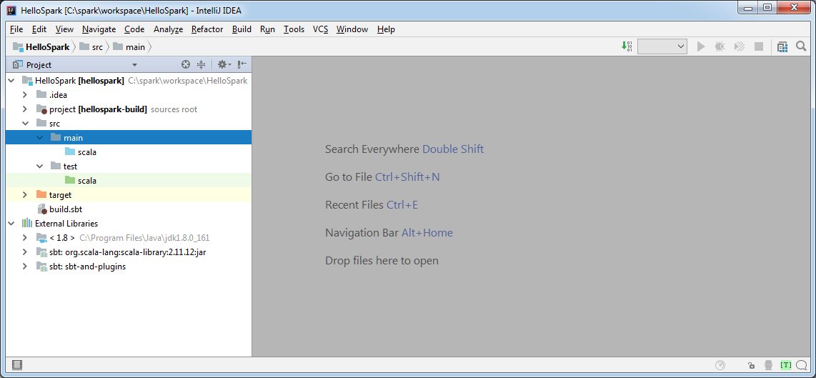
Project layout
Notes:
When done, you can notice that SBT project structure is totally the same one used in Maven projects.

Slide 35
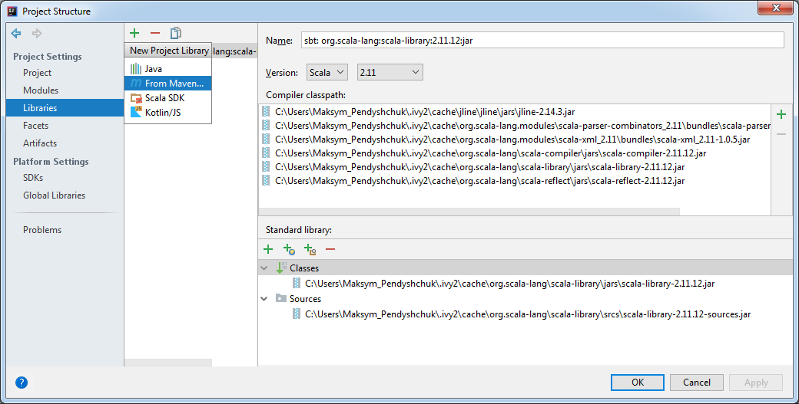
Libraries configuration
2
3
1

Slide 36
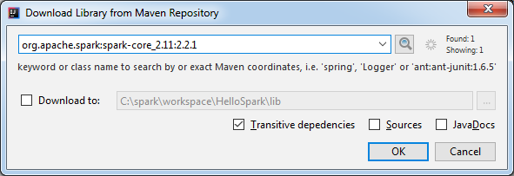
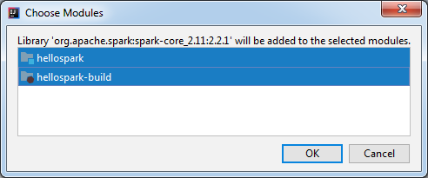
Spark 2.2.1
1
2
3
4
Notes:
But it is not enough. All we have is a proper project structure, and since we are going to use Apache Spark, we need to add those libraries. In IDEA please navigate “File -> Project Structure…” or press Ctrl+Alt+Shift+S. In the windows pop up select Libraries on its left, then click on green plus button and choose “From Maven…” in the options list.

Slide 37
Libraries we need
Package | Artifact ID
org.apache.spark:spark-core_2.11:2.2.1 | spark-core_2.11
org.apache.spark:spark-sql_2.11:2.2.1 | spark-sql_2.11
Notes:
In the window shown please type in “org.apache.spark:spark-core_2.11:2.3.0”, which is a maven “name” for Apache Spark Core library, and press ok, then select both modules in a new window, meaning that this maven library should be used for both your new Spark app and Spark app build sources, and press OK.

Slide 38

Hello World a Spark Way
package com.epam.sample.spark // import required spark classes import org.apache.spark.{SparkConf, SparkContext} // define main method (Spark entry point) object HelloSpark { def main(args: Array[String]) { // initialise spark context val conf = new SparkConf() .setAppName("HelloSpark") .setMaster("local[*]") val sc = new SparkContext(conf) // do stuff println("Hello, Spark world!") // terminate spark context sc.stop() } }
Notes:
When all the steps are completed, we are good to write our first Hello World app. Create a new Spark object (File -> New -> Scala Class, then enter a name for class, for instance HelloSpark, and select Object as a kind of Scala class). When ready, you can run that code…

Slide 39
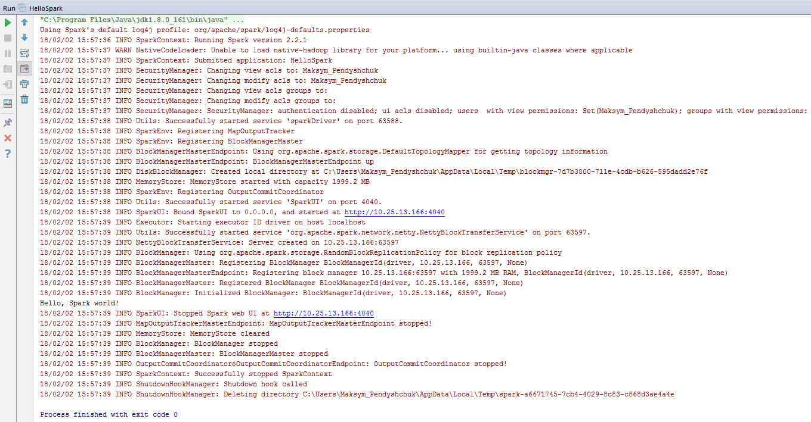
Setup validation
Notes:
.. and on the IDEA console you will see a bunch of logs, and “Hello, Spark world!” somewhere in between. Please note, that message was not produced by Spark, we print it directly in our code, so it itself does not mean we are good to go, but an absence of error messages mean.

Slide 40
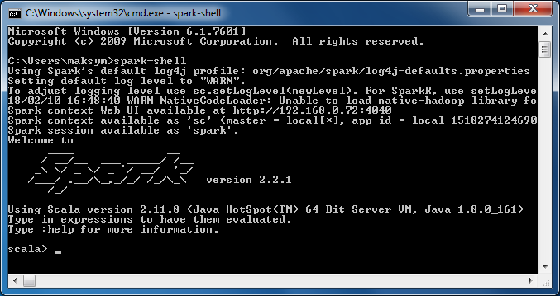
Spark REPL
Notes:
One more option to play with Spark is to use its command line shell: Spark REPL.

Slide 41
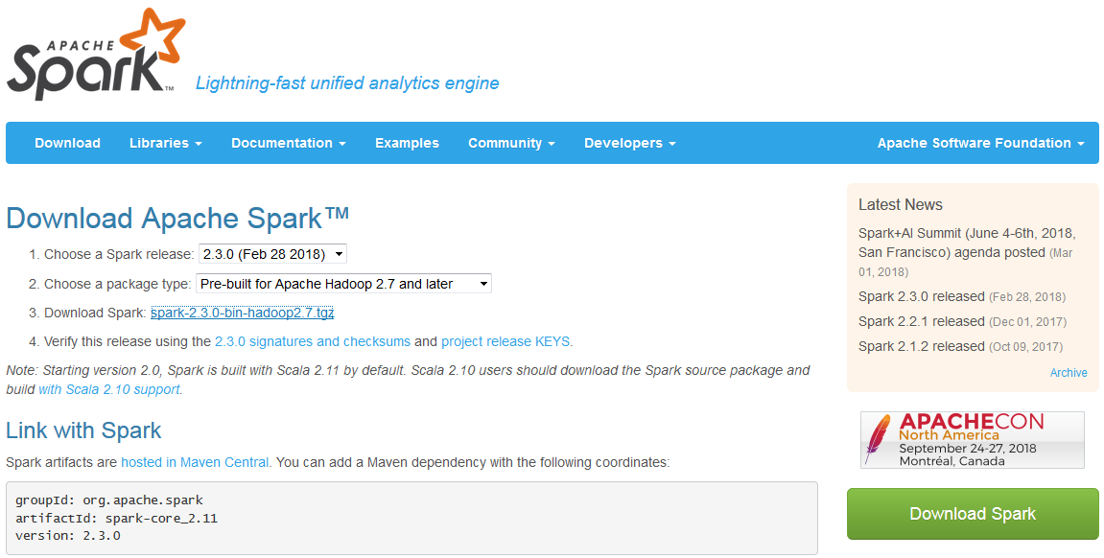
Spark Distribution
Notes:
To do so, we need to download Apache Spark binaries. Please note we use the latest version (2.3.0) and Hadoop 2.7.

Slide 42
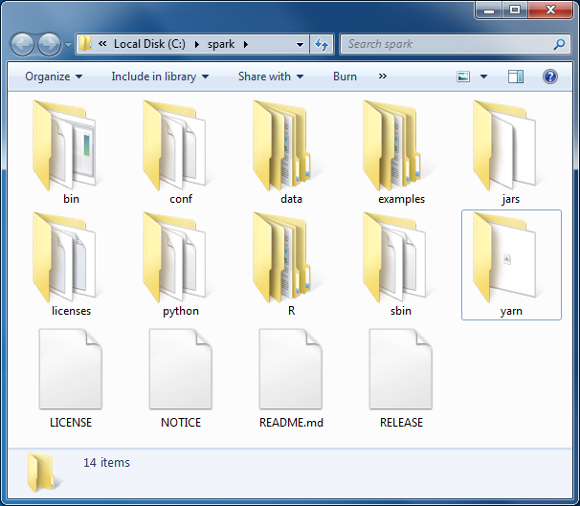
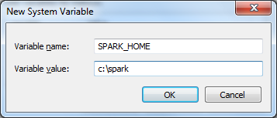
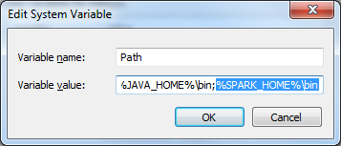
Spark distribution installation
1
2
3
Notes:
To do so, we need to download Apache Spark binaries. Please note we use the latest version (2.3.0) and Hadoop 2.7.

Slide 43
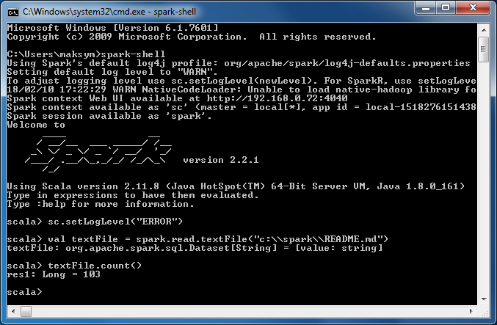
Testing Spark CLI
Notes:
To do so, we need to download Apache Spark binaries. Please note we use the latest version (2.3.0) and Hadoop 2.7.

Slide 44
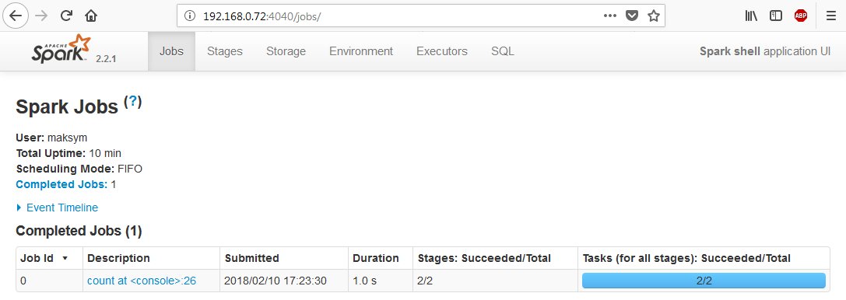
Spark UI
Notes:
To do so, we need to download Apache Spark binaries. Please note we use the latest version (2.3.0) and Hadoop 2.7.

Slide 45
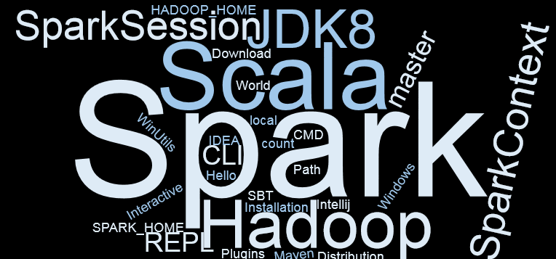
Summary
Notes:
You’ve learned how to get Apache Spark installed, and what options are to run some Spark code, what tools are available out-of-the-box for Spark development.

Slide 46
RDD and its operations

Slide 47
What is RDD?
RDDs are fault-tolerant, parallel data structures that let users explicitly persist intermediate results in memory, control their partitioning to optimize data placement, and manipulate them using a rich set of operators.
RDD
Parallel
Transform
Notes:
Resilient Distributed Dataset (aka RDD) is the primary data abstraction in Apache Spark and the core of Spark
If you compare RDDs to collections in Scala, an RDD is computed on many JVMs while a Scala collection lives on a single JVM.
Using RDD Spark hides data partitioning and so distribution that in turn allowed them to design parallel computational framework with a higher-level programming interface (API) for four mainstream programming languages.
The features of RDDs (decomposing the name):
Resilient, i.e. fault-tolerant with the help of RDD lineage graph and so able to recompute missing or damaged partitions due to node failures.
Distributed with data residing on multiple nodes in a cluster.
Dataset is a collection of partitioned data with primitive values or values of values, e.g. tuples or other objects (that represent records of the data you work with).
SOURCES:
https://jaceklaskowski.gitbooks.io/mastering-apache-spark/content/spark-rdd.html

Slide 48
Partitioning
val rdd = sc.parallelize(1 to 30)
Notes:
Now as we know what RDD is, let’s talk about one of the most basic concept – a partition:
Partition is a logical chunk of a large data set.
Very often data we are processing can be separated into logical partitions (for example, payments from the same country, ads displayed for given cookie, etc). In Spark, they are distributed among nodes when shuffling occurs.
Spark can run 1 concurrent task for every partition of an RDD (up to the number of cores in the cluster). If you’re cluster has 20 cores, you should have at least 20 partitions (in practice 2–3x times more). From the other hand a single partition typically shouldn’t contain more than 128MB and a single shuffle block cannot be larger than 2GB.
In the example shown, we generate a list of 1 to 30 numbers and create an RDD from them. Once created, Spark partitions the data and we can get 4 partitions with a possible distribution shown. Having 3 Spark workers, it can mean that first worker has first two partitions hosted, and the rest of worked next partitions.
SOURCES:
- https://medium.com/parrot-prediction/partitioning-in-apache-spark-8134ad840b0

Slide 49
RDD Features
Coarse-Grained Operation
Location-Stickness
In-Memory Computation
Partitioning
Lazy Evaluation
Persistence
Immutability
Fault Tolerance
Notes:
RDD is a fundamental Spark Structure, and as such it has number of shining features:
In-Memory, i.e. data inside RDD is stored in memory as much (size) and long (time) as possible.
Immutable or Read-Only, i.e. it does not change once created and can only be transformed using transformations to new RDDs.
Lazy evaluated, i.e. the data inside RDD is not available or transformed until an action is executed that triggers the execution.
Persistence, i.e. you can hold all the data in a persistent "storage" like memory (default and the most preferred) or disk (the least preferred due to access speed).
Partitioned — records are partitioned (split into logical partitions) and distributed across nodes in a cluster.
Location-Stickiness — RDD can define placement preferences to compute partitions (as close to the records as possible), i.e. DAGScheduler places the partitions in such a way that task is close to data as much as possible.
Coarse-grained operation – it applies to all elements in dataset through maps or filter or group by operation, i.e. transformations are applied to the whole dataset, but not individual elements on the dataset (no get(index) or set(index) transformations)
Fault Tolerance – RDDs are fault tolerant as they track data lineage information to rebuild lost data automatically on failure, i.e. each RDD remembers how it was created from other datasets to recreate itself.
SOURCES:
https://data-flair.training/blogs/apache-spark-rdd-tutorial/

Slide 50
Operations on RDD
Spark Transformation is a function that produces new RDD from the existing RDDs.
Spark Action are RDD operations that produce non-RDD values.
Notes:
RDDs support two kinds of operations:
transformations - lazy operations that return another RDD.
actions - operations that trigger computation and return values.
SOURCES:
http://www.360doc.com/content/15/1105/10/7362_510880755.shtml
https://www.slideshare.net/SparkSummit/transformations-and-actions-a-visual-guide-training
http://backtobazics.com/category/big-data/spark/

Slide 51
Transformation types
Notes:
Narrow Transformation
Input and output stays in same partition
No data movement is needed
Wide Transformation:
Input from other partitions are required
Data shuffling is needed before processing

Slide 52
Narrow Transformations
map(func)
flatMap(func)
filter(func)
mapPartition(func)
mapPartitionWithIndex(func)
union(dataset)
zip(dataset)
zipWithIndex()
zipWithUniqueId()
Notes:
There are many Narrow Transformations supported by Spark, among them: map, flatMap, filter, mapPartition, mapPartitionWithIndex, union, zip, zipWithIndex, zipWithUniqueId

Slide 53
Basic Transformations
map(func)
val z = sc.parallelize(1 to 3) .map(i => i*i) // 1, 4, 9
filter(func)
val z = sc.parallelize(1 to 3) .filter(i => i % 2 == 1) // 1, 3
union(dataset)
val x = sc.parallelize(1 to 3) val y = sc.parallelize(3 to 5) val z = x.union(y) // 1, 2, 3, 3, 4, 5
Notes:
Let’s have a look at the basic narrow transformations Spark offers:
map returns a new distributed dataset formed by passing each element of the source through a function func. For instance, we have an RDD with a list of 1 to 5, and we would like to create a new RDD having squares of all the values from the initial RDD. The piece of code given makes exactly that, and we can see that it does not change partitions initial RDD had: on the picture we see initial RDD x with two rectangles A and B inside (meaning partitions) with values inside (blue rectangles: 1,2 in A and 3 in B). Then applying mapping we get a new RDD z with still same partitions A and B with new values inside (1 and 4 in A, and 9 in B; which are squares of respective x values)
filter returns a new dataset formed by selecting those elements of the source on which func returns true. For example, for the same input as previously we can filter out even values. As a result we have still same partitions with even numbers missing.
union returns a new dataset that contains the union of the elements in the source dataset and the argument. For instance, we can have two RDDs x and y, with 1 to 5 and 3 to 8 lists respectively, the result RDD z will have all the values from both x and y RDDs with all same partitions.
SOURCES:
https://spark.apache.org/docs/latest/rdd-programming-guide.html

Slide 54
Data Mapping
flatMap(func)
val x = sc.parallelize(1 to 3, 2)
val z = x.flatMap(x => List(x,x)) // 1, 1, 2, 2, 3, 3
val x = sc.parallelize(1 to 3, 2)
val z = x.map(x => List(x,x)) // [1, 1], [2, 2], [3, 3]
mapPartitions(func)
func must be of type Iterator<T> => Iterator<U>
val x = sc.parallelize(1 to 3)
val z = x.mapPartitions(x => List(x.next).iterator) // 1
val x = sc.parallelize(1 to 3, 2)
val z = x.mapPartitions(x => List(x.next).iterator) // 1, 3
mapPartitionsWithIndex(func)
func must be of type (Int, Iterator<T>) => Iterator<U>
val x = sc.parallelize(1 to 3)
val z = x.mapPartitionsWithIndex( (index, iter) => iter.toList.map(x => index + ", "+x).iterator) // 0, 1, 0, 2, 0, 3
val x = sc.parallelize(1 to 3, 2)
val z = x.mapPartitionsWithIndex( (index, iter) => iter.toList.map(x => index + ", "+x).iterator)
// 0, 1, 0, 2, 1, 3
Notes:
We already know how to map RDD values, but there are few more useful mapping transformations.
flatMap is similar to map, but each input item can be mapped to 0 or more output items (so func should return a Seq rather than a single item). In the example we create an initial RDD having 1,2,3 values, and ask Spark to create exactly 2 partitions. Next step we first map each RDD value to a pair [value, value] as a list. So we get an RDD with values [1,1], [2,2], [3,3] and then we apply flatMap transformation, i.e. we get a new RDD with “unflatten” values 1,1,2,2,3,3 in the same partitions. Please compare what would happen if we apply mapping intsead (a code on a right side) => our result RDD remains same pairs [1,1],[2,2],[3,3]
mapPartitions is also similar to map, but runs separately on each partition (block) of the RDD, so func must be of type Iterator<T> => Iterator<U> when running on an RDD of type T. Result of this transformation highly depends on partitions we have. For instance, having same input as for flatMap, we run it on each partition (A and B), mapping to the fist value in that partition, so as a result we have a new RDD with still two partitions, but 1 and 3 values only. Please compare with a result if we have one partition only; in this case 1 partition results in one value, the first value of the only partition – 1.
mapPartitionsWithIndex, with no surprise, is similar to mapPartitions, but also provides func with an integer value representing the index of the partition, so func must be of type (Int, Iterator<T>) => Iterator<U> when running on an RDD of type T. Sounds complex, so let’s move on the an example. Still having an input RDD as two partitions with 1 to 3 numbers. Now for each value we have its partition index, meaning partition A is a first partition (so index is 0), B is a second partition (so index is 1), and we map each integer value of initial RDD to a string, a comma separated index and value, therefore “0, 1”, “0, 2”, “1, 3”. Please compare what whould happen if we only have one partition, i.e. each index is the same - 0
SOURCES:
https://spark.apache.org/docs/latest/rdd-programming-guide.html

Slide 55
Zipping
zip(datase)
val x = sc.parallelize('A' to 'C',2) val y = sc.parallelize(1 to 3, 2)
val z = x.zip(y) // (A,1), (B,2), (C,3)
zipWithIndex()
val x = sc.parallelize('A' to 'C',2) val z = x.zipWithIndex() // (A,0), (B,1), (C,2)
zipWithUniqueId()
val x = sc.parallelize('A' to 'C',2)
val z = x.zipWithUniqueId() // (A,0), (B,1), (C,3)
Notes:
Zipping two RDDs with N elements each is a way to get new N elements where each value is a function on elements on same position in initial RDDs. Spark has few transformations for that:
zip zips this RDD with another RDD, returning key-value pairs (PairRDD) with the elements pair. For instance, if we have two RDDs with (‘A’, ‘B’, ‘C’) first, and (1, 2, 3) second and we try to zip them, then we get a new RDD with pairs (‘A’, 1), (‘B’, 2), (‘C’, 3). It’s like a hash map with ‘A’, ‘B’, ‘C’ as keys, and 1,2,3 as values for them respectively
zipWithIndex zips RDD with its indexes. i.e. the first item in the first partition gets index 0, and the last item in the last partition receives the largest index. In this case, if we try to zip an RDD with (‘A’, ‘B’, ‘C’) values with their indexes we get (‘A’, 1), (‘B’, 2), (‘C’, 3). Please note, indexes do not depend on partitions.
zipWithUniqueId zips this RDD with generated unique Long ids. Items in the kth partition will get ids k, n+k, 2*n+k, …, where n is the number of partitions. For the same input RDD (‘A’ in first partition, and ‘B’, ‘C’ in second partition), we get 0 for A (zero index partition), then 1 for B (1 index partition), and 1+2 for C (1 index partition + 2 partitions overall)
SOURCES:
Spark JavaDoc

Slide 56
Wide Transformations
intersection(dataset)
distinct([numTasks])
groupByKey([numTasks])
reduceByKey(func, [numTasks])
sortByKey([ascending], [numTasks])
join(dataset, [num)
coalesce(numTasks)
cartesian(dataset)
repartition(numTasks)
Notes:
Having done with Narrow Transformations, let’s move on to Wide ones. Let us remind, Wide Transformations require data shuffling between nodes.
There are many Wide Transformations supported by Spark, among them: intersection, disctinct, groupByValue, reduceByKey, sortByKey, join, coalesce, cartesian, repartition

Slide 57
Intersection, Distinct
intersection(dataset)
val x = sc.parallelize(1 to 5) val y = sc.parallelize(3 to 6, 2) val z = x.intersection(y)
// 4, 3, 5
distinct([numTasks])
val x = sc.parallelize(Array(1, 2, 1, 3, 2), 2) val z = x.distinct()
// 1, 3, 2
Notes:
Probably the simplest wide transformations are intersect and distinct:
intersection returns a new RDD that contains the intersection of elements in the source dataset and the argument. Let’s imagine we have two RDD, first one consists of 1 to 5 integers, and has one partition only; another one consists of 3 to 6 integers and has two partitions. When we apply intersection to them, then data are shuffled between nodes (repartitioning) and we get two new partitions (say A and B) with 4 and 3,5 values respectively
distinct returns a new dataset that contains the distinct elements of the source dataset. For instance, in the simplest case, if we have an RDD with some values duplicated (say 1,2,1,3,2) and run disctint transformation, then we get a new RDD with unique values only. Please note, the values might change partitions…
SOURCES:
https://spark.apache.org/docs/latest/rdd-programming-guide.html

Slide 58
Managing Partitions
input
val x = sc.parallelize(1 to 6, 4)
// [1], [2, 3], [4], [5, 6]
coalesce(numPartitions)
val z = x.coalesce(2)
// [1, 2, 3], [4, 5, 6]
repartition(numPartitions)
val z = x.repartition(2)
// [1, 2, 4, 5], [3, 6]
Notes:
It’s a time to learn how we can manage partitions. There are two basic transformations for that:
coalesce decreases the number of partitions in the RDD to the given one. Useful for running operations more efficiently after filtering down a large dataset. For instance, if we have an RDD with 1 to 6 integers, spread around 4 partitions, we can easily decrease partitions to 2 running coalesce(2) on it.
repartition changes number of partitions in the RDD to the given one. It means we can also decrease partitions to 2 with help of repartition. Decreasing number of partitions does not mean we get equal partitions, i.e. RDD values are not distributed equally, like we see in this case.
SOURCES:
https://spark.apache.org/docs/latest/rdd-programming-guide.html

Slide 59

Increasing Partitions
input
val x = sc.parallelize(1 to 6, 4)
// [1], [2, 3], [4], [5, 6]
repartition
val z = x.repartition(5) println(z.getNumPartitions) // 5 val zPartitions = z.glom().collect zPartitions.foreach(println(_.mkString("[", ", ", "]"))) // [5], [1, 2, 6], [3], [], [4]
coalesce
val z = x.coalesce(5) println(z.getNumPartitions) // 4 val zPartitions = z.glom().collect zPartitions.foreach(println(_.mkString("[", ", ", "]"))) // [1], [2, 3], [4], [5, 6]
Notes:
So what’s the difference between coalesce and repartition? The only thing coalesce can do is decreasing number of partitions, when repartition can increase them as well.
Having same input RDD (1 to 6 integers, 4 partitions), we can do both transformations trying to increase partitions to 5, and see what happens. In case of repartition we indeed get 5 partitions, please note how values were distributed – one partition is empty (!), few have 1 value only and one has 3 values (!), remember that repartitioning does mean equal value distribution… it is just a repartitioning, even if we get empty partitions…
coalesce in its turn did nothing. We asked to increase partitions, but in result we still have 4 partitions. At least it did not change values in partitions.
Here we learn good features of partition managing transformations: if you are not sure how many partitions you have and you do not want to increase them but possibly decrease, then coalesce is your choice. Otherwise if you are sure you need to change number of partitions, whether increasing or decreasing, then repartition is the way to go.

Slide 60

Actions
count()
collect()
take(n)
top(n)
countByValue()
reduce(func)
fold(zeroValue, func)
aggregate(zeroValue, seqOp, combOp)
foreach(func)
saveAsTextFile(path)
saveAsSequenceFile(path)
saveAsObjectFile(path)
Notes:
Another type of operations on RDD is actions. There are plenty of them supported by Spark out of the box, among them: count, collect, countByValue, reduce, fold, aggregate, saveAs actions etc.

Slide 61
Basic Actions
collect()
val x = sc.parallelize(Array(1, 2, 1, 3, 2))
.collect() // 1, 2, 1, 3, 2
count()
val x = sc.parallelize(Array(1, 2, 1, 3, 2))
.count() // 5
countByValue()
val x = sc.parallelize(Array(1, 2, 1, 3, 2)) .countByValue() // 1 -> 2, 3 -> 1, 2 -> 2
Notes:
First, let’s have a look at the basic Spark actions:
collect returns all the elements of the dataset as an array at the driver program. This is usually useful after a filter or other operation that returns a sufficiently small subset of the data. For instance, if we have an RDD created from Array given, than actual result of the collect action is going to be a list of same values.
count returns the number of elements in the dataset. In other words, if we have an RDD made from 5-elements array, then count action on such an RDD returns 5.
countByValue is similar to count, but returns a map of each unique value with its count. For the same RDD as above, the result is now not 5 but a map that we have 2 ones, 1 three, and 2 twos.

Slide 62
Collecting Rows to the Driver
take(n)
val x = sc.parallelize(Array(1, 2, 1, 3, 2))
.take(3) // 1, 2, 3
top(n)
val x = sc.parallelize(1 to 5) .top(3) // 5, 4, 3
Notes:
Sometimes we do not need all the values, and would like just to have few of them, take and top actions comes handy here:
take tries to take number of elements given from starting RDDs zero partition. Say initially we have a 1-partiion RDD, so take returns first 3 elements, 1,2,3 in our case
top tries to take number of elements gives from RDD with a default order. For the same RDD as before, top returns also 3 elements, as asked, but completely unordered now.

Slide 63
Data Aggregation
reduce(func)
val x = sc.parallelize(1 to 4) .reduce((acc, item) => acc + item) // 10
fold(zeroValue, func)
val x = sc.parallelize(1 to 4) .filter(_>10)
.fold(0)((acc, item) => acc + item) // 0
val x = sc.parallelize(1 to 4) .filter(_>10)
.reduce((acc, item) => acc + item) // UnsupportedOperationException
aggregate(zeroValue, seqOp, combOp)
val x = sc.parallelize(1 to 4) .aggregate((0, 0))( (acc, item) => (acc._1 + item, acc._2 + 1), (acc1, acc2) => (acc1._1 + acc2._1, acc1._2 + acc2._2) ) // (10,4)
Notes:
One of the most useful actions in Spark are aggregations:
reduce aggregates the elements of the dataset using a function func (which takes two arguments and returns one). The function should be commutative and associative so that it can be computed correctly in parallel. For instance, we can sum up all the elements in RDD, in this case we simply add accumulator and item (both arguments passed to reduce closure). In other words, having that written and ran, when first element is passed to that closure, accumulator’s value is 0, so 0+1 is 1 and it is assigned to accumulator. Next element is 2, so accumulator that time is 1 and item is 2 and therefore 1+2=3 is assigned to accumulator and so on.. Last run we have accumulator 6 and item 4 so the result value is 6+4=10.
fold aggregates the elements of each partition, and then the results for all the partitions, using a given associative function and a neutral “zero value”. In other words, fold is quite similar to reduce, except the fact that we can set the initial value of accumulator. When it becomes handy? Imagine we have an empty RDD, in our example we take the same initial RDD as before, and filter out all the elements (as there is nothing bigger than 10), so at this point we have a new empty RDD. Now we run fold action, saying that accumulator should be assigned 0 before calculations, and same closure as before returns 0, which is quite logically considering empty RDD. Now, on the right we have exactly the same, but using reduce action.. Reduce actions fails while running on empty RDD (!), this is important to know.
aggregate itself aggregates the elements of each partition, and then the results for all the partitions, using given combine functions and a neutral “zero value”. Let’s see what our sample code does. First we ask to assign (0, 0) to accumulator. Then first sequence operations are run (first closure passed). That function takes (0,0) as accumulator and 1 as first value and creates a pair (0+1, 0+1), then next run we get (1+2, 1+1) and so on, last run we get (6+4, 3+1).

Slide 64
ForEach, Data Saving
foreach(func)
val x = sc.parallelize(1 to 4, 2) x.foreach(println)
saveAsTextFile(path)
val x = sc.parallelize(1 to 4, 2)
x.saveAsTextFile("C:\\spark\\numbers.txt")
saveAsSequenceFile(path)
val x = sc.parallelize(1 to 4, 2)
x.map(i => (i, i*i)) .saveAsSequenceFile("C:\\spark\\numbers.sq")
saveAsObjectFile(path)
val x = sc.parallelize(1 to 4, 2)
x.saveAsObjectFile("C:\\spark\\numbers.obj")
Notes:
Last but not the least actions are data saving actions and foreach:
foreach runs a function func on each element of the dataset. This is usually done for side effects such as updating an Accumulator or interacting with external storage systems. Note: modifying variables other than Accumulators outside of the foreach() may result in undefined behavior. A simple example of using this actions is to print all RDD values.
saveAsTextFile writes the elements of the dataset as a text file (or set of text files) in a given directory in the local filesystem, HDFS or any other Hadoop-supported file system. Spark will call toString on each element to convert it to a line of text in the file. Please note, in result we will have as many files as partitions we had (in our example we have an RDD with 2 paritions, so 2 files get created)
saveAsSequenceFile writes the elements of the dataset as a Hadoop SequenceFile in a given path in the local filesystem, HDFS or any other Hadoop-supported file system. This is available on RDDs of key-value pairs that implement Hadoop's Writable interface. In Scala, it is also available on types that are implicitly convertible to Writable (Spark includes conversions for basic types like Int, Double, String, etc).
saveAsObjectFile (in Java and Scala) writes the elements of the dataset in a simple format using Java serialization, which can then be loaded using SparkContext.objectFile().
SOURCES:
https://spark.apache.org/docs/latest/rdd-programming-guide.html

Slide 65

Example
package com.epam.sample.spark import org.apache.spark.{SparkConf, SparkContext} object WordCount { def main(args: Array[String]): Unit = { val conf = new SparkConf() .setAppName(“Word Count") .setMaster("local[*]") val sc = new SparkContext(conf) val textFile = sc.textFile(args(0)) val counts = textFile.flatMap(line => line.split(" ")) .map(word => (word, 1)) .reduceByKey(_ + _) counts.saveAsTextFile(args(1)) } }
Notes:
Now, after learning many RDD operations, let’s find out what happens when we run them on RDD. Let’s take an example to count words and go step by step. Basically, we load a text file, split each string line by a whitespace, create a key/value assigning 1 to each word, and then sum up all the values for same words. Obviously the result saves to a text file ‘word: count’ for each word in the initial text.
SOURCES:
- http://www.grroups.com/blog/how-spark-deconstructed

Slide 66
Input RDD
...
val textFile = sc.textFile(args(0))
...
Far far away, behind the word mountains, far from the countries Vokalia and Consonantia, there live the blind texts. Separated they live in Bookmarksgrove right at the coast of the Semantics, a large language ocean. A small river named Duden flows by their place and supplies it with the necessary regelialia.
Notes:
First step: create an RDD from the text file given

Slide 67
Transformations
... val counts = textFile.flatMap(line => line.split(" ")) .map(word => (word, 1)) .reduceByKey(_ + _) ...
Notes:
Second step is to run all the transformations we have

Slide 68
Action
... counts.saveAsTextFile(args(1)) ...
Notes:
Next, Spark runs the action (saveAsTextFile in our case)

Slide 69
Result RDD / Value
(right,1) (away,,1) (their,1) (with,1) (behind,1) (texts.,1) (live,2) (language,1) (there,1) (mountains,,1) (river,1) (word,1) (ocean.,1) (they,1) (countries,1) (Duden,1) (from,1) (Bookmarksgrove,1) (coast,1)
(Vokalia,1) (blind,1) (it,1) (small,1) (Far,1) (necessary,1) (a,1) (regelialia.,1) (A,1) (large,1) (at,1) (in,1) (of,1) (Semantics,,1) (place,1) (far,2) (by,1) (supplies,1) (and,2) (named,1) (Consonantia,,1) (Separated,1) (the,6) (flows,1)
Notes:
And we get a result value.

Slide 70
Lazy Evaluation
Notes:
All said before is true.. Well, almost all.. Spark won’t process our text file exactly as said. Spark maintains the lineage of transformations, but does not immediately evaluate until an action is called. That said, Sparks sees that RDD get created from a text file, but does nothing, then it sees that we do some transformations and still runs nothing, and only when action is performed, Spark finally evaluates all the steps skipped before for that RDD. This is one of the most important Spark RDD features.

Slide 71
PairRDD
RDD[String]
RDD[Tuple[String, Int]]
RDD[(String, Int)]
.map(word => Tuple2(word, 1))
.map(word => (word, 1))
Pair RDD
Notes:
Spark provides special operations on RDDs containing key/value pairs. These RDDs are called pair RDDs. Pair RDDs are a useful building block in many programs, as they expose operations that allow you to act on each key in parallel or regroup data across the network.
SOURCES:
https://www.safaribooksonline.com/library/view/learning-spark/9781449359034/ch04.html

Slide 72
Basic Transformations
mapValues(func)
val x = sc.parallelize(Array(('A', 1), ('B', 2), ('C', 3)))
val z = x.mapValues(i => i*i) // (A,1), (B,4), (C,9)
flatMapValues(func)
val x = sc.parallelize(Array(('A', 1), ('B', 2), ('C', 3)))
val z = x.flatMapValues(i => List(i,i)) // (A,1), (A,1), (B,2), (B,2), (C,3), (C,3)
keys() & values()
val x = sc.parallelize(Array(('A', 1), ('B', 2), ('C', 3)))
val keys = x.keys // A, B, C
val values = x.values // 1, 2, 3
Notes:
Basic transformations supported by Spark on PairRDD are:
mapValues applies a function to each value of a pair RDD without changing the key. For an RDD given (‘A’,1),(‘B’,2),(‘C’,3), when we apply mapValues with square function we get same RDD but with square values of the first RDD. This transformation is very similar to map for a plain RDD.
flatMapValues applies a function that returns an iterator to each value of a pair RDD, and for each element returned, produce a key/value entry with the old key. Often used for tokenization. Similar to flatMap we saw a while ago.
keys return an RDD of just the keys. In other words, having (‘A’,1),(‘B’,2),(‘C’,3) RDD, running keys transformation we get ‘A’,’B’,’C’ in result.
values is similar to keys, it returns an RDD of just the values. Similarly, for (‘A’,1),(‘B’,2),(‘C’,3) RDD we get 1,2,3 as our result.
SOURCES:
https://www.safaribooksonline.com/library/view/learning-spark/9781449359034/ch04.html

Slide 73
Transformations based on Keys
groupByKey([numTasks])
val x = sc.parallelize(Array((‘B', 1), ('B', 2), (‘A', 3) , (‘A’, 4) , (‘B’, 5)))
val z = x.groupByKey() // (B, [1, 2, 5]), (A, [3, 4]))
reduceByKey(func, [numTasks])
val x = sc.parallelize(Array((‘B', 1), ('B', 2), (‘A', 3) , (‘A’, 4) , (‘B’, 5)))
val z = x.reduceByKey((acc, item) => acc+item) // (B,8), (A,7)
aggregateByKey(zeroValue)(seqOp, combOp, [numTasks])
val x = sc.parallelize(Array((‘B', 1), ('B', 2), (‘A', 3) , (‘A’, 4) , (‘B’, 5)))
val z = x.aggregateByKey((0, 0))( (acc, item) => (acc._1 + item, acc._2 + 1), (acc1,acc2) => (acc1._1 + acc2._1, acc1._2 + acc2._2) ) // (B,(8,3)), (A,(7,2))
sortByKey([ascending], [numTasks])
val x = sc.parallelize(Array((‘B', 1), ('B', 2), (‘A', 3) , (‘A’, 4) , (‘B’, 5)))
val z = x.sortByKey() // (A,3), (A,4), (B,1), (B,2), (B,5)
Notes:
There are more transformations on PairRDD that we might find useful to know, here come few more:
groupByKey groups values with same key. So if we create an RDD from [(‘B', 1), ('B', 2), (‘A', 3) , (‘A’, 4) , (‘B’, 5)] and group it by key, then we get rid of duplicating keys (couple of As and Bs), and get values grouped: B gets [1,2,5] as a value, when A gets [3,4] as value.
reduceByKey combines values with same key. For instance, for the same initial RDD we can sum up all the values for each key. Similar to reduce we saw before, but reducing gets applied for key values.
aggregateByKey aggregates values with the same key using the given combine functions and a neutral "zero" value. Similar to aggregate transformation, but here all the aggregations are applied by keys.
sortByKey returns an RDD sorted by the key.
SOURCES:
https://www.safaribooksonline.com/library/view/learning-spark/9781449359034/ch04.html

Slide 74
Two PairRDD Transformations
subtractByKey(otherDataset, [numTasks])
val x = sc.parallelize(Array(('C', 1), ('B', 2), ('A', 3), ('A', 4))) val y = sc.parallelize(Array(('A', 8), ('B', 7), ('A', 6), ('D', 5))) val z = x.subtractByKey(y) // (C,1)
cogroup(otherDataset, [numTasks])
val x = sc.parallelize(Array(('C', 1), ('B', 2), ('A', 3), ('A', 4))) val y = sc.parallelize(Array(('A', 8), ('B', 7), ('A', 6), ('D', 5))) val z = x.cogroup(y) // (B,([2],[7])), (A,([3, 4],[8, 6])), (C,([1],[])), (D,([],[5]))
join(otherDataset, [numTasks])
val x = sc.parallelize(Array(('C', 1), ('B', 2), ('A', 3), ('A', 4))) val y = sc.parallelize(Array(('A', 8), ('B', 7), ('A', 6), ('D', 5))) val z1 = x.join(y) val z2 = x.leftOuterJoin(y) val z3 = x.rightOuterJoin(y)
Notes:
Sometimes we have two pair rdds and want to apply some transformations on both of them. Couple of options available:
subtractByKey remove elements with a key present in the other RDD.
cogroup groups data from both RDDs sharing the same key. This operation is also called groupWith.
join performs an inner join between two RDDs. When called on datasets of type (K, V) and (K, W), returns a dataset of (K, (V, W)) pairs with all pairs of elements for each key. Outer joins are supported through leftOuterJoin, rightOuterJoin, and fullOuterJoin.
SOURCES:
https://www.safaribooksonline.com/library/view/learning-spark/9781449359034/ch04.html

Slide 75
Actions on PairRDD
countByKey()
val x = sc.parallelize(Array(('B', 1), ('B', 2), ('A', 3), ('A', 4), ('B', 5))) val z = x.countByKey() // B -> 3, A -> 2
collectAsMap()
val x = sc.parallelize(Array(('B', 1), ('B', 2), ('A', 3), ('A', 4), ('B', 5))) val z = x.collectAsMap() // A -> 4, B -> 5
lookup(key)
val x = sc.parallelize(Array(('B', 1), ('B', 2), ('A', 3), ('A', 4), ('B', 5))) val z = x.lookup('A') // 3, 4
Notes:
Besides of transformations, there are also couple of actions available to be run on pair RDDs:
countByKey count the number of elements for each key.
collectAsMap collects the result as a map to provide easy lookup.
lookup returns all values associated with the provided key.
SOURCES:
https://www.safaribooksonline.com/library/view/learning-spark/9781449359034/ch04.html

Slide 76
Shuffle
.map(word => (word, 1))
.reduceByKey(_ + _)
Notes:
Shuffling is a process of redistributing data across partitions (aka repartitioning) that may or may not cause moving data across JVM processes or even over the wire (between executors on separate machines).
Shuffling is the process of data transfer between stages.
By default, shuffling doesn’t change the number of partitions, but their content.
We should avoid shuffling at any cost, better think about ways to leverage existing partitions. Leverage partial aggregation to reduce data transfer. For example, instead of using groupByKey we can use reduceByKey or combineByKey instead:
groupByKey shuffles all the data, which is slow.
reduceByKey shuffles only the results of sub-aggregations in each partition of the data.
SOURCES:
https://jaceklaskowski.gitbooks.io/mastering-apache-spark/content/spark-rdd-shuffle.html

Slide 77

Shared Variables
Accumulators
counters or sums that can be reliably used in parallel processing
native support for numeric types, extensions possible via API
workers can modify state, but cannot read content
only a driver program can read the accumulated value
Broadcast variables
allow for an efficient sharing of potentially large data sets
intended for workers as reference data
cached, transported via broadcast protocol, (de)serializedGraph processing
Notes:
Normally, when a function passed to a Spark operation (such as map or reduce) it is executed on a remote cluster node, it works on separate copies of all the variables used in the function. These variables are copied to each machine, and no updates to the variables on the remote machine are propagated back to the driver program. Supporting general, read-write shared variables across tasks would be inefficient. However, Spark does provide two limited types of shared variables for two common usage patterns: broadcast variables and accumulators.
Accumulators are variables that are only “added” to through an associative and commutative operation and can therefore be efficiently supported in parallel. They can be used to implement counters (as in MapReduce) or sums. Spark natively supports accumulators of numeric types, and programmers can add support for new types.
Broadcast variables allow the programmer to keep a read-only variable cached on each machine rather than shipping a copy of it with tasks. They can be used, for example, to give every node a copy of a large input dataset in an efficient manner. Spark also attempts to distribute broadcast variables using efficient broadcast algorithms to reduce communication cost.
SOURCES:
https://spark.apache.org/docs/latest/rdd-programming-guide.html#shared-variables
http://www.tomaszezula.com/2015/12/20/apache-spark-basics-accumulators-and-broadcast-variables/
https://github.com/zezutom/spark-by-example/blob/master/README.md

Slide 78
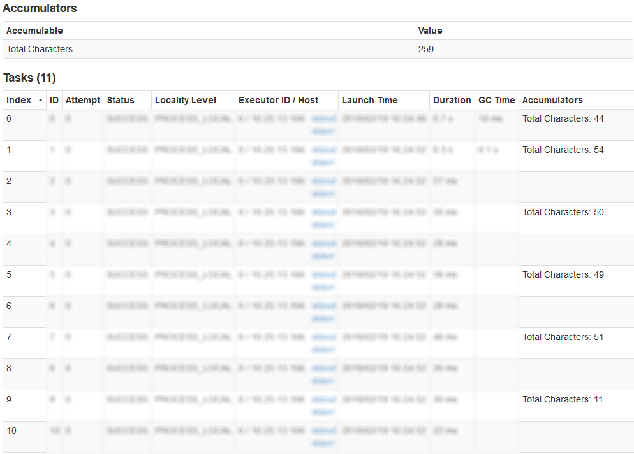
Accumulators
val totalChars: LongAccumulator = sc.longAccumulator("Total Characters") val counts = textFile.flatMap(line => line.split(" "), 10) .map(word => {totalChars.add(word.length); word}) .map(word => (word, 1)) .reduceByKey(_ + _) counts.saveAsTextFile(args(1)) println(s"Total number of characters: ${totalChars.value}")
Notes:
Suppose we don’t need to just count the words in our text, but would like to know how many letters are there (with no matter the letters, a total count only). As the text is broken into smaller chunks processed in parallel, the counting part naturally lends itself to the use of accumulators.
In our code we first create a new accumulator (called totalChars), and then somewhere in transformations we create an actually dummy transformations: one which runs on a word, but does not change it, adds our accumulator length of that word and returns word. This trick of mapping does not change our word counting processing flow, but keeps accumulators increasing with each word.
If we go to Spark UI we can also see our accumulator there, and can even double check that its value was properly added from our tasks.
SOURCES:
http://www.tomaszezula.com/2015/12/20/apache-spark-basics-accumulators-and-broadcast-variables/

Slide 79
Broadcast
val commonWords = sc.broadcast(Array("a", "an", "the", "of", "by", "in", "at", "to", "for")) val counts = textFile.flatMap(line => line.split(" ")) .filter(!commonWords.value.contains(_)) .map(word => (word, 1)) .reduceByKey(_ + _) counts.saveAsTextFile(args(1))
Notes:
Another idea could be to remove common words. An effort to “describe” the book by extracting the most frequent words is surely somewhat more exciting than just counting characters. One of the first challenges is with words which are typically overused, but do not carry any significant information, such as articles, prepositions, pronouns and even some verbs. Our application maintains a list of these words and ensures they are ruled out when parsing the book content.
This is when broadcast variables come into play. The list of common words could potentially run long and it would be inefficient to create a copy in a each and every worker. Using a broadcast variable helps performance via caching and reduced network traffic thanks to a specialized broadcast protocol.
First we create a broadcast variable with frequently used words, and then use it to filter out words from our text. That variable get created in SparkContext and ‘broadcasted’ to all the worker nodes to be used ‘locally’
SOURCES:
http://www.tomaszezula.com/2015/12/20/apache-spark-basics-accumulators-and-broadcast-variables/

Slide 80
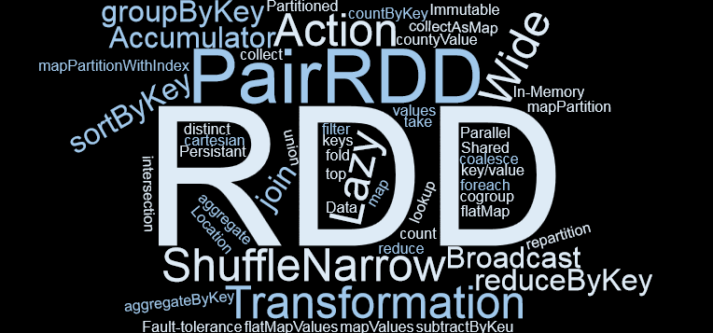
Summary
Notes:
You’ve learned:
what kind of operations are supported by Apache Spark
what kind of abstractions exist (RDD and Pair RDD)
how Spark evaluates our code
what shared variables mean
Congratulations, you passed first part of Spark Core session

Slide 81
THANK YOU!
MAKSYM_PENDYSHCHUK@EPAM.COM

